Slide 1
Programme Steering Group CR012 Impact Assessment Report & Recommendations
30 November 2022

Slide 2
CR012 – Impact Assessment Summary
Objective of this session:
PSG to review the outputs of CR012 Impact Assessment and SRO to make decision.
If CR012 is approved, the Programme recommends that: delivery of M6 would be rescheduled in the round 3 replan (subject to Ofgem approval) according to the Programme’s impact assessment and a small wording change is made to the CCAG terms of reference proposed in CR012 as below.
Headlines:
A significant majority of respondents supported the request to increase the scope of the Programme code drafting activities to include drafting of consequential change. To deliver the change, the Cross-Code Advisory Group ​(CCAG) Terms of Reference, including Objectives, Purpose & Duties and Scope, Deliverables, Roles and Responsibilities​ sections need to be updated. Programme planning assumptions will be required to include consequential code changes that are not directly from approved Design Artefacts.
Respondents did not provide quantifiable benefits to counter the Programme’s estimate of increased cost, but responses generally stated that there was a case for this change on the basis of industry-wide cost efficiency. The analysis therefore relies upon empirical evidence obtained via qualitative information in responses.
The overall response rate for CR012 (12%). In total, 19 respondents supported the change, 2 respondents rejected the change and 3 respondents abstained.
Specifically, 13 respondents agreed with the change with unqualified support.
A single set of code drafting that encompasses all the change required to deliver MHHS will be a more robust and efficient process than progressing ‘core’ and ‘consequential’ change through separate mechanisms. This will enable Programme Parties to see all MHHS related code changes in one place, increasing the likelihood of successful implementation and supporting the achievement of the benefits associated with MHHS.
The change will reduce the likelihood of re-work being required to other changes or MHHS to align a number of changes and it will reduce the likelihood of any changes required not being in place when they are required.
6 respondents supported the change, but highlighted the following considerations:
CCAG should agree some form of prioritisation if resource is stretched between approval of MHHS design related code and MHHS consequential change related code. This could be considered if the Code drafting was considered likely to delay M6 or be on the critical path.
If the change is approved, the Programme will confirm with Ofgem how all code drafting (whether 'core' or 'consequential') will be designated by Ofgem using its code change implementation powers. As there will be no Change/Modification, the words 'Code change requests and modifications' could/should be replaced with 'Code changes' to avoid the risk of potential misunderstandings. [MHHSP propose this change is made]
The Programme may be required to provide additional support to Code Bodies to support the smooth progression of CPs that sit outside the programme. [MHHSP will support this activity]
2 respondents rejected the change:
Whilst the proposed concept could have worked, it comes too late as the Code Drafting Plan commences January 2023 and lacks both the quantitative and qualitative facts and details to, a) persuade us of the benefits and b) for it to be implemented as a live process before January 2023.
Unclear whether CR012 brings any benefit that is not already allowed for in the current CCAG Terms of Reference.
Document Classification: Public

Slide 3
CR012 – Submitted Impact Assessments
Please see appendix for full detail on CR012 Impact Assessment
Programme Parties |  | CR012 Recommendations
 |  | Yes | No | Abstained | Not Replied
Large Suppliers |  | 3 | - | - | 3
Medium Suppliers |  | 1 | - | - | 6
Small Suppliers |  | - | - | - | 33
I&C |  | 2 | - | - | 39
DNOs |  | 7 | - | - | -
iDNOs |  | 1 | - | - | 12
Ind. Agents |  | - | 2 | 1 | 45
Supplier Agents |  | - | - | - | 5
S/W Providers |  | - | - | - | 25
Electralink (DCUSA) |  | 1 | - | - | -
REC Code Manager |  | 1 | - | - | -
National Grid |  | 1 | - | - | -
Consumer |  | - | - | - | 1
Elexon (Helix) |  | 1 | - | - | -
DCC |  | 1 | - | - | -
SRO / IM & LDP |  | - | - | 1 | -
IPA |  | - | - | 1 | -
Market Share
Yes | No | Abstained | Not Replied
59% | - | - | 41%
24% | - | - | 76%
- | - | - | 100%
30% | - | - | 70%
100% | - | - | -
Market Share information is according to the latest Meter Point Administration Number (MPAN) data held by the Programme as at November 2022. Market Share has not been provided for constituencies where MPAN data is not currently available.
The classification of Independent and Supplier Agents is maintained by the Programme Party Coordinator and is subject to change.
Rationale for being marked down as ‘abstained’
One respondent cautioned that despite the quantity of work required from the change, the M6 Milestone not moving renders delivery untenable. [note that the Programme has proposed additional activities for Code drafting that would move M6 later]
The Programme stated the industry should agree this change and the Programme should abstain from the decision making.
The IPA highlighted the change is not expected to have an impact on our activities and has no specific objections to the request.
Document Classification: Public

Slide 4
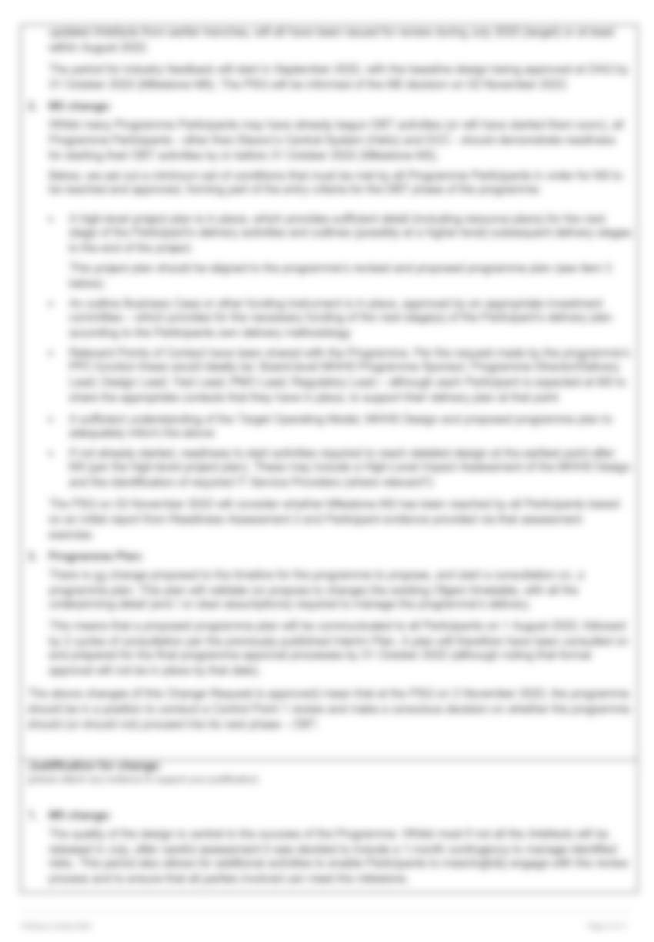
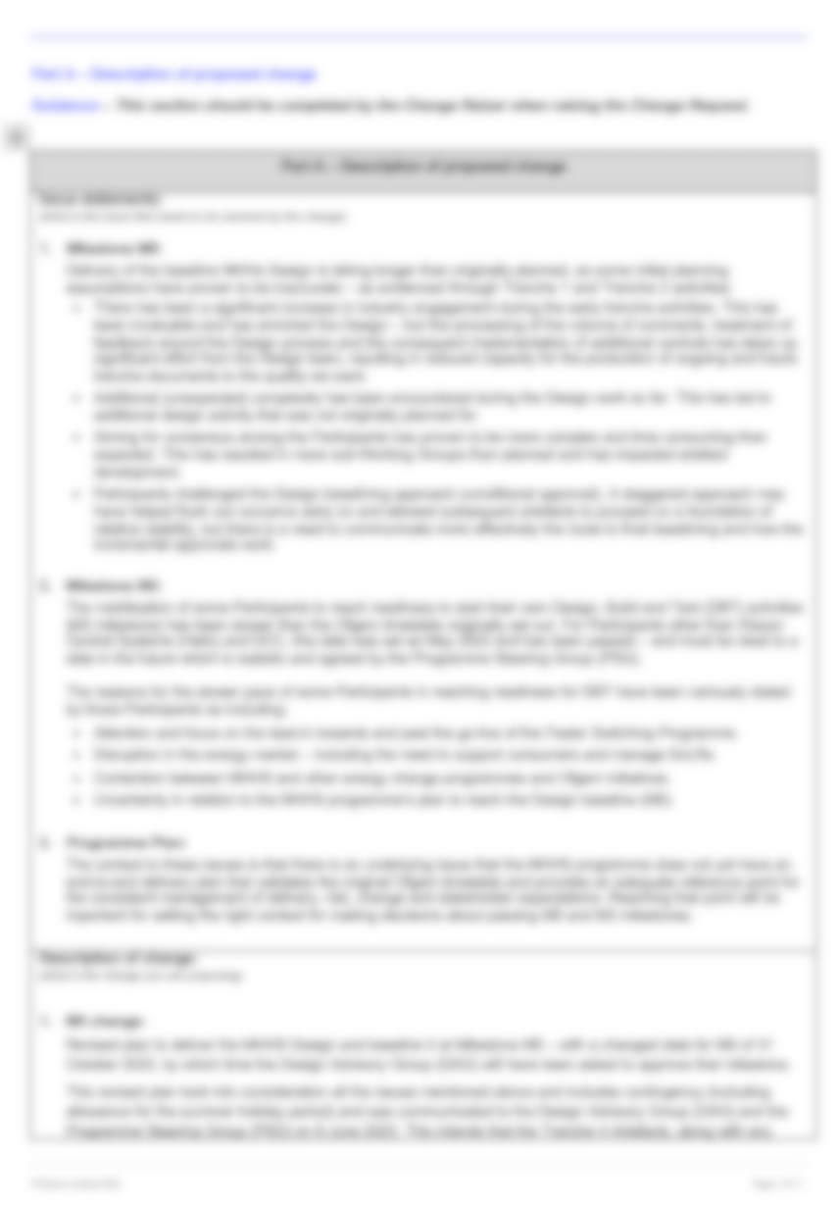
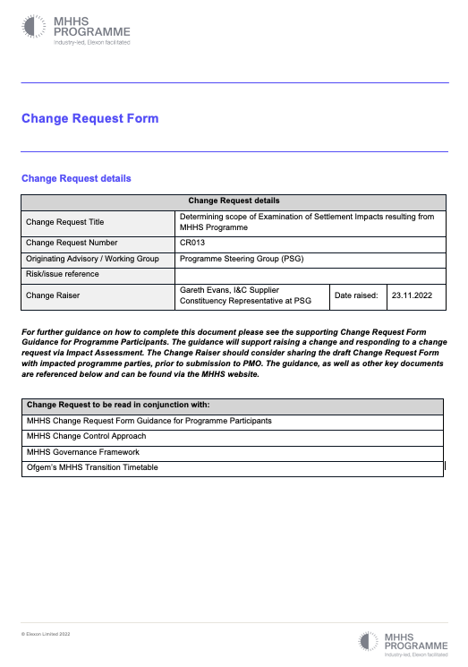
CR013 overview
Objective: Agree to raise CR013 for impact assessment
Determining scope of Examination of Settlement Impacts resulting from MHHS Programme
CR013 was raised to the Change Control process and validated by Change Board on 29-Nov-22
Issue Statement:
The MHHS programme will result in a significant change to how settlement processes work in the retail electricity sector as it moves from a predominately NHH settlement regime using estimation algorithms to the use of actual consumption reads for the majority of sites.
The system and operational processes to deliver this change are well understood and has been the subject of significant development. By contrast, comparatively little work has been done as to what the impact will be on settlement from this move from majority estimated to majority actual consumption. The magnitude of change to settlement that will occur as sites migrate is therefore poorly understood, but could potentially impact a large number of areas of the settlement regime, including Group Correction Factors, Line Losses, etc.
Description of change:
It is proposed that a piece of work is undertaken to understand what areas the MHHS programme should look at when assessing the impact that moving HH settlement will have on the balancing regime and settlement. The scoping will potentially need to look at all areas of the balancing and settlement regime, though the focus will need to be on those processes directly related to SVA consumption.
The expectation is that the MHHS programme will create a report setting out the areas it believes require detailed assessment. The work on assessing settlement impact would be progressed through another Change Request.
Justification for change:
Significant time and effort is expended by the industry in attempting to ensure that the current settlement regime is as accurate as possible, but ultimately is reliant on estimates to derive a NHH site’s consumption. Movement of a site from NHH to HH settlement status will mean a corresponding change to its settlement profile, even if the site’s behaviour does not change. This will change the settlement dynamics of the market as energy is reallocated from one settlement profile to another and is likely to have knock-on impacts on other areas such as Line Losses, etc.
Without understanding the nature and scope of the changes to the market there is a risk that the market will experience unwarranted volatility as expected and actual settlement positions diverge. This will potentially increase balancing costs as imbalances positions widen.
Target date by which a decision is required: 11-Jan-23 at PSG. The timelines for an impact assessment and reporting require PSG consideration.
MHHS-DEL792 CR013
Document Classification: Public

Slide 5
Detailed Programme Party views

Slide 6
CR012 Impacts – Views on the proposed approach (Page 1)
Programme Parties | Range of respondents’ views on benefits and concerns (related to the approach in CR012)
Large Suppliers | Respondents unanimously supported the overall recommendation to approve the change A single set of code drafting that encompasses all the change required to deliver MHHS will be a more robust and efficient process than progressing ‘core’ and ‘consequential’ change through separate mechanisms. The proposed approach will also support the achievement of the wider benefits of MHHS, by industry and by consumers. Consumers will only achieve the benefits of MHHS if industry parties successfully implement not only the changes to settlement processes set out in the MHHS design, but the consequential changes that ensure that design supports other, non-settlement processes such as switching. Enable parties to see all MHHS related code changes in one place, increasing the likelihood of successful implementation and supporting the achievement of the benefits associated with MHHS. The ‘core’ and ‘consequential’ elements of the changes required to deliver Faster Switching were developed independently of each other, leaving individual parties to try and pull all of that together into an end-to-end design, which in some cases led to misunderstanding or misinterpretation. While most of these issues were identified in end-to-end testing before go-live, many of them could and should have been avoided through the sort of joined up, end-to-end approach that is being proposed here. The change will ensure duplication of effort (driving increase Code Body and participant resourcing) or gaps in the scope between MHHS and consequential change (leading to Code drafting issues and sign off problems) are reduced. The potential for cost / resource reduction is not guaranteed as parties will need to plan for the same amount of work Clarification is needed regarding how the consequential change scope is to be validated and how this will be managed by CCAG. One respondent was unsure whether the change covers only REC consequential changes or whether it goes further and covers SEC and DCUSA.
Medium Suppliers | Addresses issues already experienced with consequential change being progressed outside of the programme scope, even in instances where this has significant impact on programme design and priorities i.e MP162. Overdue change that is necessary and will have a positive impact in terms of mitigating risk and providing improved clarity for programme change.
Small Suppliers | Did not respond to Impact Assessment
I&C | Respondents unanimously supported the overall recommendation to approve the change MHHS code and wider consequential changes managed centrally will provide control, oversight and transparency for all stakeholders. A centralised industry group reviewing all change is a more efficient and consistent way of delivering and implementing code changes across the industry and therefore should reduce the risks on the E2E solution not working effectively.
Agents | Whilst the concept being proposed could have worked, it comes too late (as the Code Drafting Plan commences January 23) and lacks both the quantitative and qualitative facts and details to, a) persuade us of the benefits and b) for it to be implemented as a live process before January 2023. Unclear whether CR012 brings any benefit that is not already allowed for in the current CCAG Terms of Reference. A more attainable milestone date should be applied for M6. The milestone is a pre-requisite of the Performance testing in Qualification (which will require consequential changes to have been made) so not only is the M6 milestone date in question but also subsequent activities.
Document Classification: Public

Slide 7
CR012 Impacts – Views on the proposed approach (Page 2)
Programme Parties | Range of respondents’ views on benefits and concerns (related to the approach in CR012)
DNOs | The efficiency of the CCAG undertaking these additional code changes may well make Code consultation review more straightforward, thereby reducing the timescales that parties may require for this activity.
iDNOs | Respondents unanimously supported the overall recommendation to approve the change. Improve transparency of consequential changes to codes impacted by the new MHHS arrangements and the more effective co-ordination between the Code Managers regarding such changes. Enable final planning for code drafting to be completed ahead of drafting commencement in January 2023. Bring cohesion and transparency across code changes which can only benefit industry and the MHHS programme overall.
S/W Providers | Did not respond to Impact Assessment
Electralink (DCUSA) | Code governance is impacted negatively by the Programme approving the changes rather than the relevant code. In DCUSA code changes are agreed by Parties and the votes reflected in the change report. This part of the process is lost with it coming under the governance of the Programme. Additional costs may be incurred across the industry if it is approved subject to the revised Programme plan to deliver the changes e.g. these may increase if a fixed time for delivery approach is agreed whereas under the code developed approach, the end date is known, and all proposed changes can be delivered within that timeline. Additional reviews are likely, and more meetings anticipated by the CDWG. The change would mitigate the Critical programme dependencies in part, but it is still reliant on the codes and code bodies identifying the changes and developing the solution before moving them into the programme. A process for monitoring these is required which we expect to be the CCIAG. The current process is via the Horizon Scanning log and discussion at the CCAG. The CCAG has agreed the code drafting plan for delivering MHHS code change in early 2024. RECCo’s assumption was that all changes to the REC required to deliver the MHHS arrangements would be delivered as part of this plan e.g. changes to the supplier exception processes would be captured within the registration workstream and changes to the performance assurance requirements would be captured within the governance and qualification workstream. Therefore, this CR will not amend RECCo’s drafting assumptions or impact the overall RECCo schedule. If the change is not approved a revised timeline will need to be developed by RECCo outside the MHHSP to include the progression of REC change proposals outside the scope of programme governance. Other code bodies would need to impact assess this change and confirm if there is an impact on their schedule.
REC Code Manager | The REC Code Manager has received repeated feedback through impact assessments and consultations on MHHS related CPs that progression outside the programme makes it difficult for REC stakeholders to make fully informed assessments and plans. Furthermore, the Code Manager is supportive that CR012 would alleviate these concerns by avoiding additional change in a piecemeal approach. Changes to the codes should be progressed under arrangements that remove as much risk as possible to Consumer outcomes. Delivering the benefits and removing the risks set out in this CR gives the best opportunity to protect Consumers interests. Assumption of joined up delivery of the MHHS arrangements is aligned to that of RECCo and resource planning supports this. A separate workstream of code drafting activity and governance will require additional, sometimes duplicated activity, which therefore means additional effort and demands on the REC Code Manager’s capacity in the same timeframes. If this CR is not approved, code drafting and approval will be subject to the standard REC Change Management process. Alignment of consultations for the consequential drafting to the existing consultation cycles set out in the programme code drafting plan may not be possible.
Document Classification: Public

Slide 8
CR012 Impacts – Views on the proposed approach (Page 3)
Programme Parties | Range of respondents’ views on benefits and concerns (related to the approach in CR012)
National Grid | Failure to implement the proposed change would result in further revised timelines which could lead to delays across other project milestones. Whilst not impacted by this change to REC, should be delivered along with other codes in early 2024 (subject to adjustments within the current MHHS Re-plan, where all milestone dates could move)
Consumer | Did not respond to Impact Assessment
Elexon (Helix) | Provide clarity and efficiency to ensure that industry participants understand the route that all the changes required to deliver MHHS will take. Reduce the likelihood of re-work being required to other changes or MHHS to align a number of changes and it will reduce the likelihood of any changes required not being in place when they are required. All code drafting (whether 'core' or 'consequential') will be designated by Ofgem using its Smart Meters Act Powers. As there will be no Change/Modification Respondent suggests that the words 'Code change requests and modifications' could/should therefore be replaced with 'Code changes' to avoid the risk of potential
DCC | CCAG should agree some form of prioritisation if resource is stretched between approval of MHHS design related code and MHHS consequential change related code. The Programme should confirm with Ofgem (as regulator) it is comfortable with using its code change implementation powers to support the change.
SRO / IM & LDP | Response is based on the evidence presented at the time of drafting, which is prior to receipt of Impact Assessment responses from Programme Participants. Our view on the impact on consumers and cost efficiency is therefore subject to change following review of Impact Assessments responses and consideration of feedback. Response is based on assumption that Code drafting is facilitated by Smart Meter Act Powers and designated by Ofgem. CR012 approval could lead to a precedent to keep opening-up the Programme scope. Especially as the scope was directed by Ofgem more than a year ago. Whilst the centralisation of Code drafting is likely to be more efficient for industry, it introduces additional cost and time to Code drafting activities within the MHHS Programme and introduces a risk that Code drafting activities end up on the Critical Path of the MHHS Programme.
IPA | Comfortable that the change request is not expected to have an impact on our activities and has no specific objections to CR012.
Document Classification: Public

